Slide 1

Slides developed by Mine Çetinkaya-Rundel of OpenIntro
Translated from LaTeX to Google Slides by Curry W. Hilton of OpenIntro.
The slides may be copied, edited, and/or shared via the CC BY-SA license
To make a copy of these slides, go to File > Download as > [option], as shown below. Or if you are logged into a Google account, you can choose Make a copy... to create your own version in Google Drive.

Slide 2
Continuous
Distributions

Slide 3
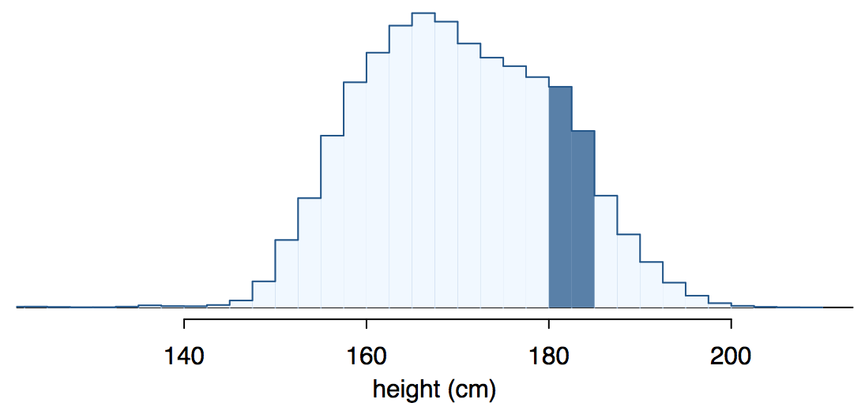
Continuous distributions
Below is a histogram of the distribution of heights of US adults.
The proportion of data that falls in the shaded bins gives the probability that a randomly sampled US adult is between 180 cm and 185 cm (about 5'11" to 6'1").

Slide 4
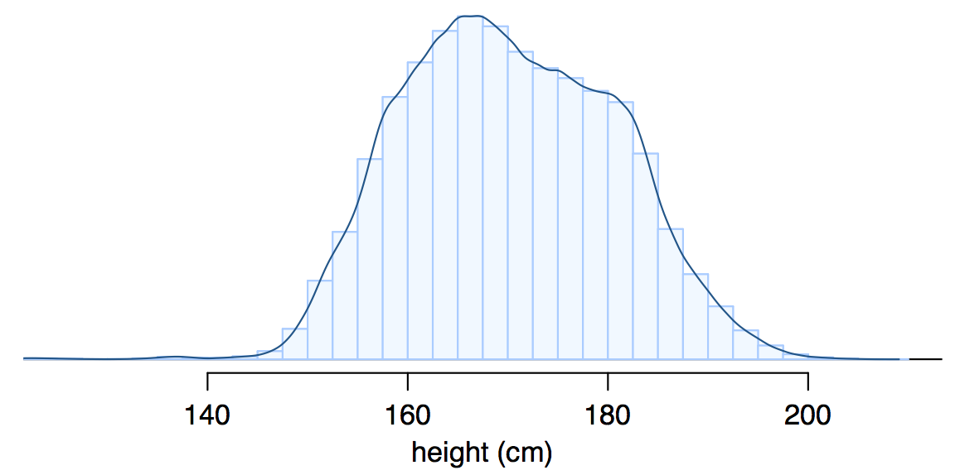
From histograms
to continuous distributions
Since height is a continuous numerical variable, its probability density function is a smooth curve.

Slide 5
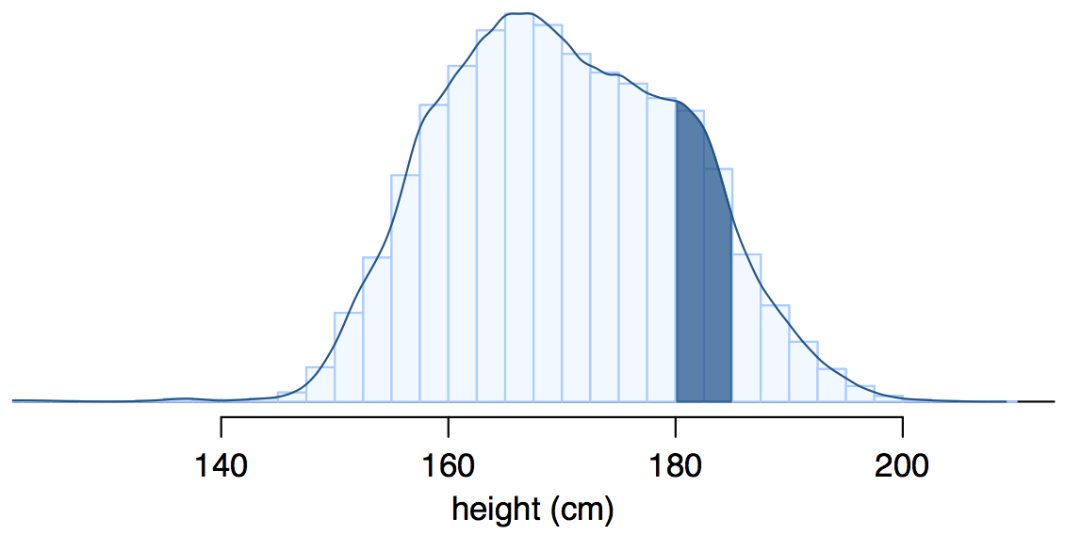
Probabilities from
continuous distributions
Therefore, the probability that a randomly sampled US adult is between 180 cm and 185 cm can also be estimated as the shaded area under the curve.

Slide 6
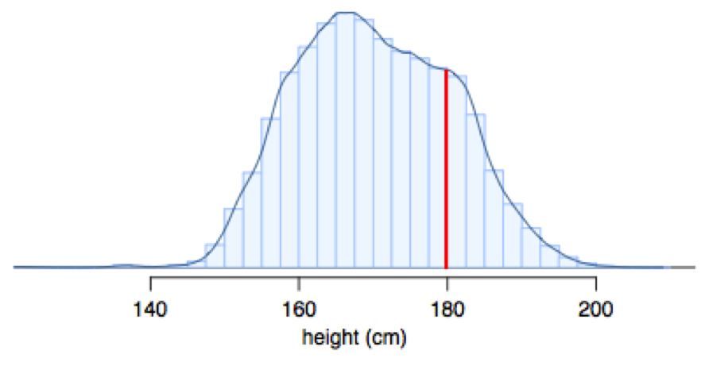
By definition...
Since continuous probabilities are estimated as “the area under the curve”, the probability of a person being exactly 180 cm (or any exact value) is defined as 0.

Slide 7
Find more resources at openintro.org/os, including
Slides
Videos
Statistical Software Labs
Discussion Forums (free support for students and teachers)
Learning Objectives
Teachers only content is also available for Verified Teachers, including
Exercise solutions
Sample exams
Ability to request a free desk copy for a course
Statistics Teachers email group
Questions? Contact us.

